Slide 1

Introduction to AI & Workflow Automation

Slide 2
Part 1: What is AI?
Understanding the core concepts, evolution, and current impact of Artificial Intelligence.

Slide 3

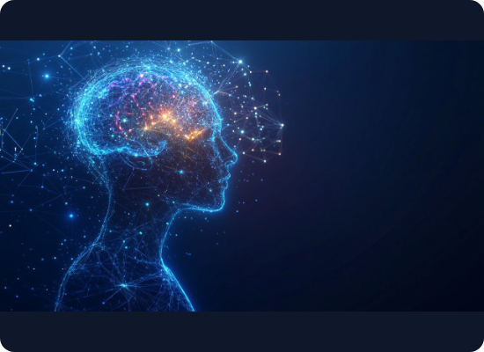
What is Artificial Intelligence?
→
The core definition: AI refers to computer systems capable of performing tasks that typically require human intelligence.
→
Sense & Comprehend: Algorithms process massive amounts of unstructured data (text, vision, audio) to understand context.
→
Act & Learn: Systems make decisions, generate content, and adapt their models over time based on feedback and new data.
→
Not just science fiction: AI is a practical utility actively reshaping industries from healthcare to finance.

Slide 4
The Evolution of AI
2000s: Machine Learning
2020s: Generative AI
Algorithms begin learning patterns from structured data without being explicitly programmed for every scenario.
Advanced foundation models (LLMs) that don't just classify data, but synthesize entirely new text, code, and imagery.
1980s: Rule-Based Systems
2010s: Deep Learning
"Expert Systems" programmed with explicit IF-THEN rules by humans. Rigid and difficult to scale.
Multi-layered neural networks process complex, unstructured data (like images and human speech) with high accuracy.

Slide 5




Three Pillars of Modern AI
memory
auto_awesome
Machine Learning (ML)
Deep Learning
Generative AI
The foundation. Training algorithms to find patterns in historical data to make predictions or decisions on new, unseen data.
A subset of ML utilizing artificial neural networks with multiple layers. It excels at complex tasks like image and speech recognition.
Models trained on vast datasets that create novel, high-quality content (text, audio, code, images) based on natural language prompts.

Slide 6

The Current Landscape (2026)
AI is now the standard.
91%
In 2026, 91% of businesses are utilizing AI in at least one capacity, up significantly from previous years. The global AI market revenue has surpassed $514 Billion.
Enterprise Adoption
The focus has shifted entirely from "Should we adopt?" to "How do we measure ROI and scale integration?"

Slide 7
Part 2: Workflow Automation
Moving from manual, repetitive tasks to seamless, automated execution.

Slide 8
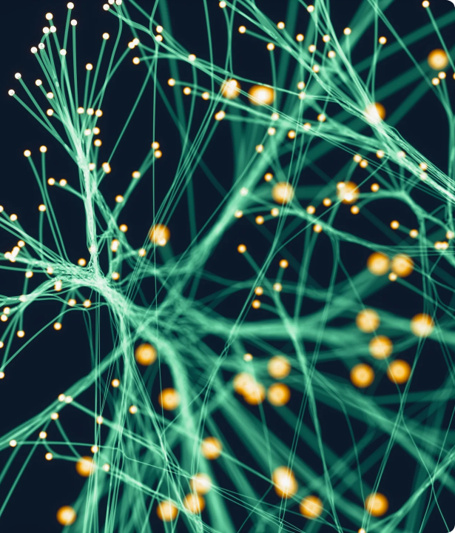
What is Workflow Automation?
Beyond Basic Task Execution
Workflow automation replaces manual processes with rule-based software logic.
It seamlessly routes data, triggers actions across disparate systems, and eliminates bottlenecks with minimal human intervention, ensuring operational consistency and speed.

Slide 9
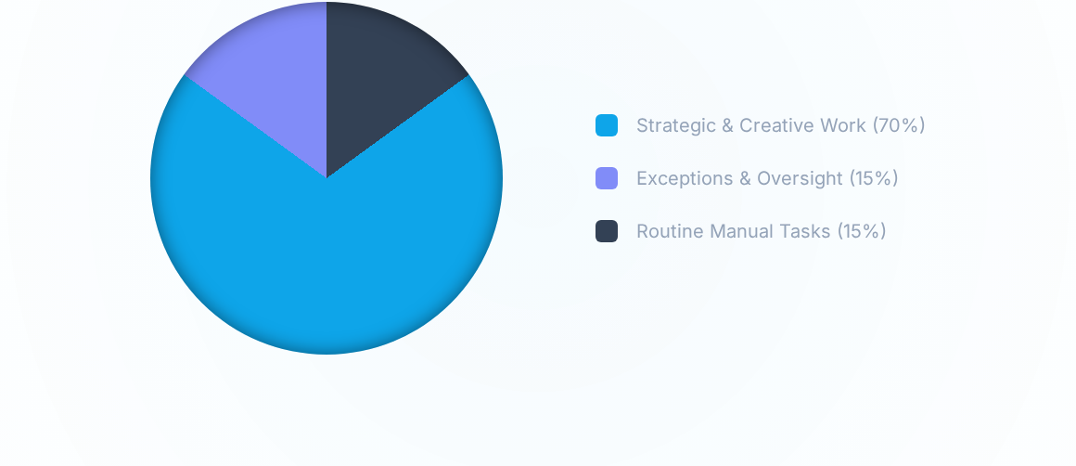
The ROI of Automation: Time Shift
By automating repetitive workflows, professionals (like marketers and developers) are saving an average of 6+ hours weekly, inverting the traditional time model to focus primarily on high-value, strategic work.

Slide 10


The Paradigm Shift: Intelligent Automation
Traditional Automation (RPA)
Intelligent Automation (AI + RPA)
Relies on strict, inflexible rules ("If this, then that").
Incorporates machine learning to adapt to exceptions and changing data.
Works only with highly structured data in predictable environments.
Can parse and process unstructured data (emails, PDFs, images) on the fly.
Breaks easily if the underlying application interface changes.
Continuously improves accuracy based on human-in-the-loop feedback.

Slide 11
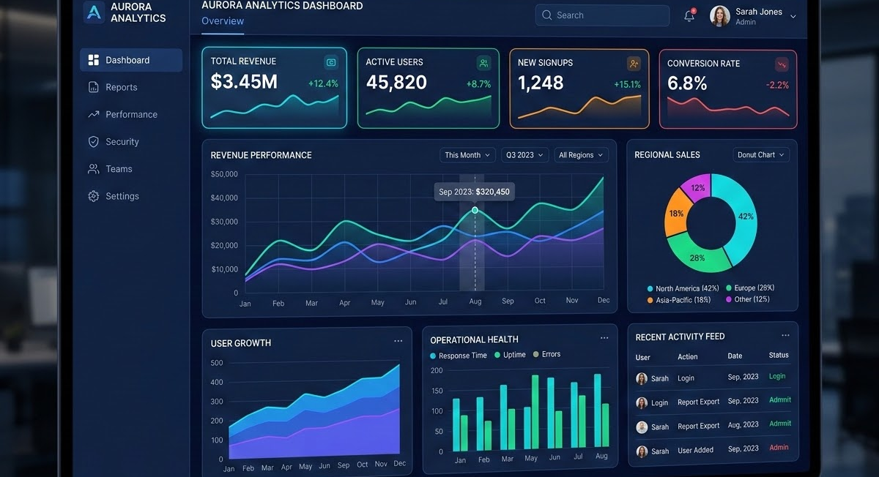




Real-World Enterprise Applications
Data Operations
Customer Success
HR Onboarding
AI automatically extracts key metrics from unstructured reports and populates dashboards instantly.
Intelligent routing categorizes support tickets by sentiment and drafts personalized initial responses.
Automated workflows provision software accounts, schedule meetings, and guide new hires dynamically.

Slide 12
Part 3: Interactive Labs
Transitioning from theory to practice with hands-on exercises.

Slide 13
Lab 1: AI in Action
Experiencing unstructured data extraction and synthesis.

Slide 14
Lab 2: Automating Workflows
Connecting applications to trigger intelligent actions.

Slide 15

Questions & Discussion
Thank you for attending Session 1.

